Slide 1
CLASS
Dated 7th April , 2025
Course Title: 5G and Wireless Technology
Course Code : ECE829
MODULE 1 of the Syllabus:-
5G Use Cases :
Three Use Case Technologies: eMBB, URLLC and mMTC
100 5G Use Case LAB at IIIT, KALYANI , Sponsored by
Dept of Tele ( DoT)
eMBB ... Enhanced Mobile Broad Band
URLLC .... Ultra Reliable Low Latency Communication
mMTC ... massive Machine Type Communication
Prof.(Dr.) Rabindranath Bera (Professor, IIIT, KALYANI)
E-mail: rbera@iiitkalyani.ac.in; Mobile : 9475513358
i

Slide 2
Outline of Presentation
5G Use Case Diagram and Technologies: eMBB, URLLC and mMTC
eMBB Use Cases in AR/VR/MR/XR
eMBB Use Cases in FWA ( Fixed Wireless Access) at SMART Home/ SOHO for wireless Broadband
eMBB in 5G Connected Car for In-Vehicle-Infotainment
mMTC use case in 5G Stadium
URLLC use case in Industry and Cars
URLLC use Case in Vehicle Platooning
Summary of 5G Use Case
100 5G Use Case LAB at IIIT, KALYANI , Sponsored by Dept of Tele ( DoT)

Slide 3
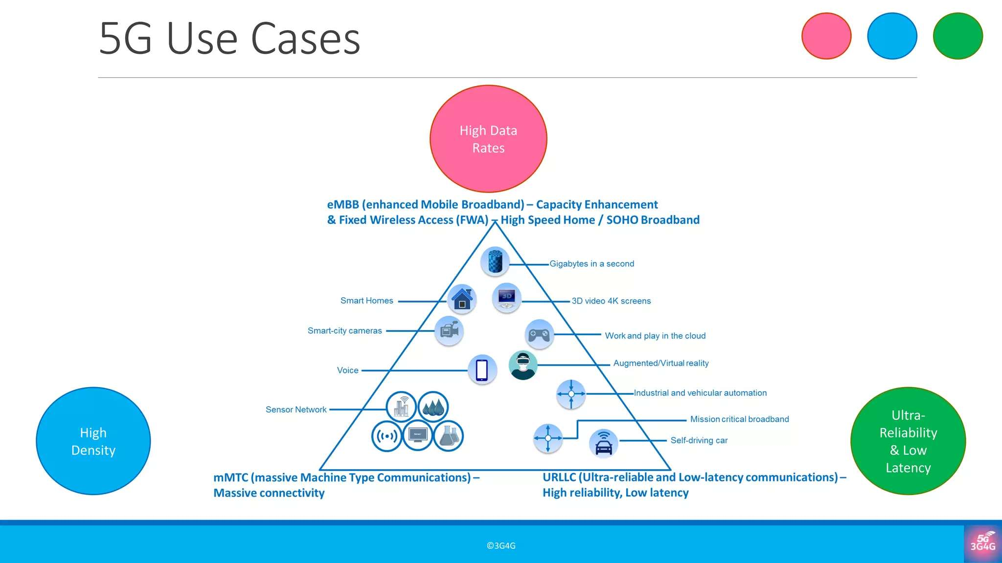
SOHO broadband" refers to internet connectivity solutions designed for small offices and home offices (SOHO), catering to the needs of businesses with 1-10 employees or individuals working from home.

Slide 5
Definition:
Augmented reality (AR) is a technology that enhances our perception of the real world by superimposing computer-generated images, videos, or information onto our surroundings.
How it works:
AR works by using devices like smartphones, tablets, or smart glasses to capture the real-world environment and then overlay digital content on top of it.

Slide 6
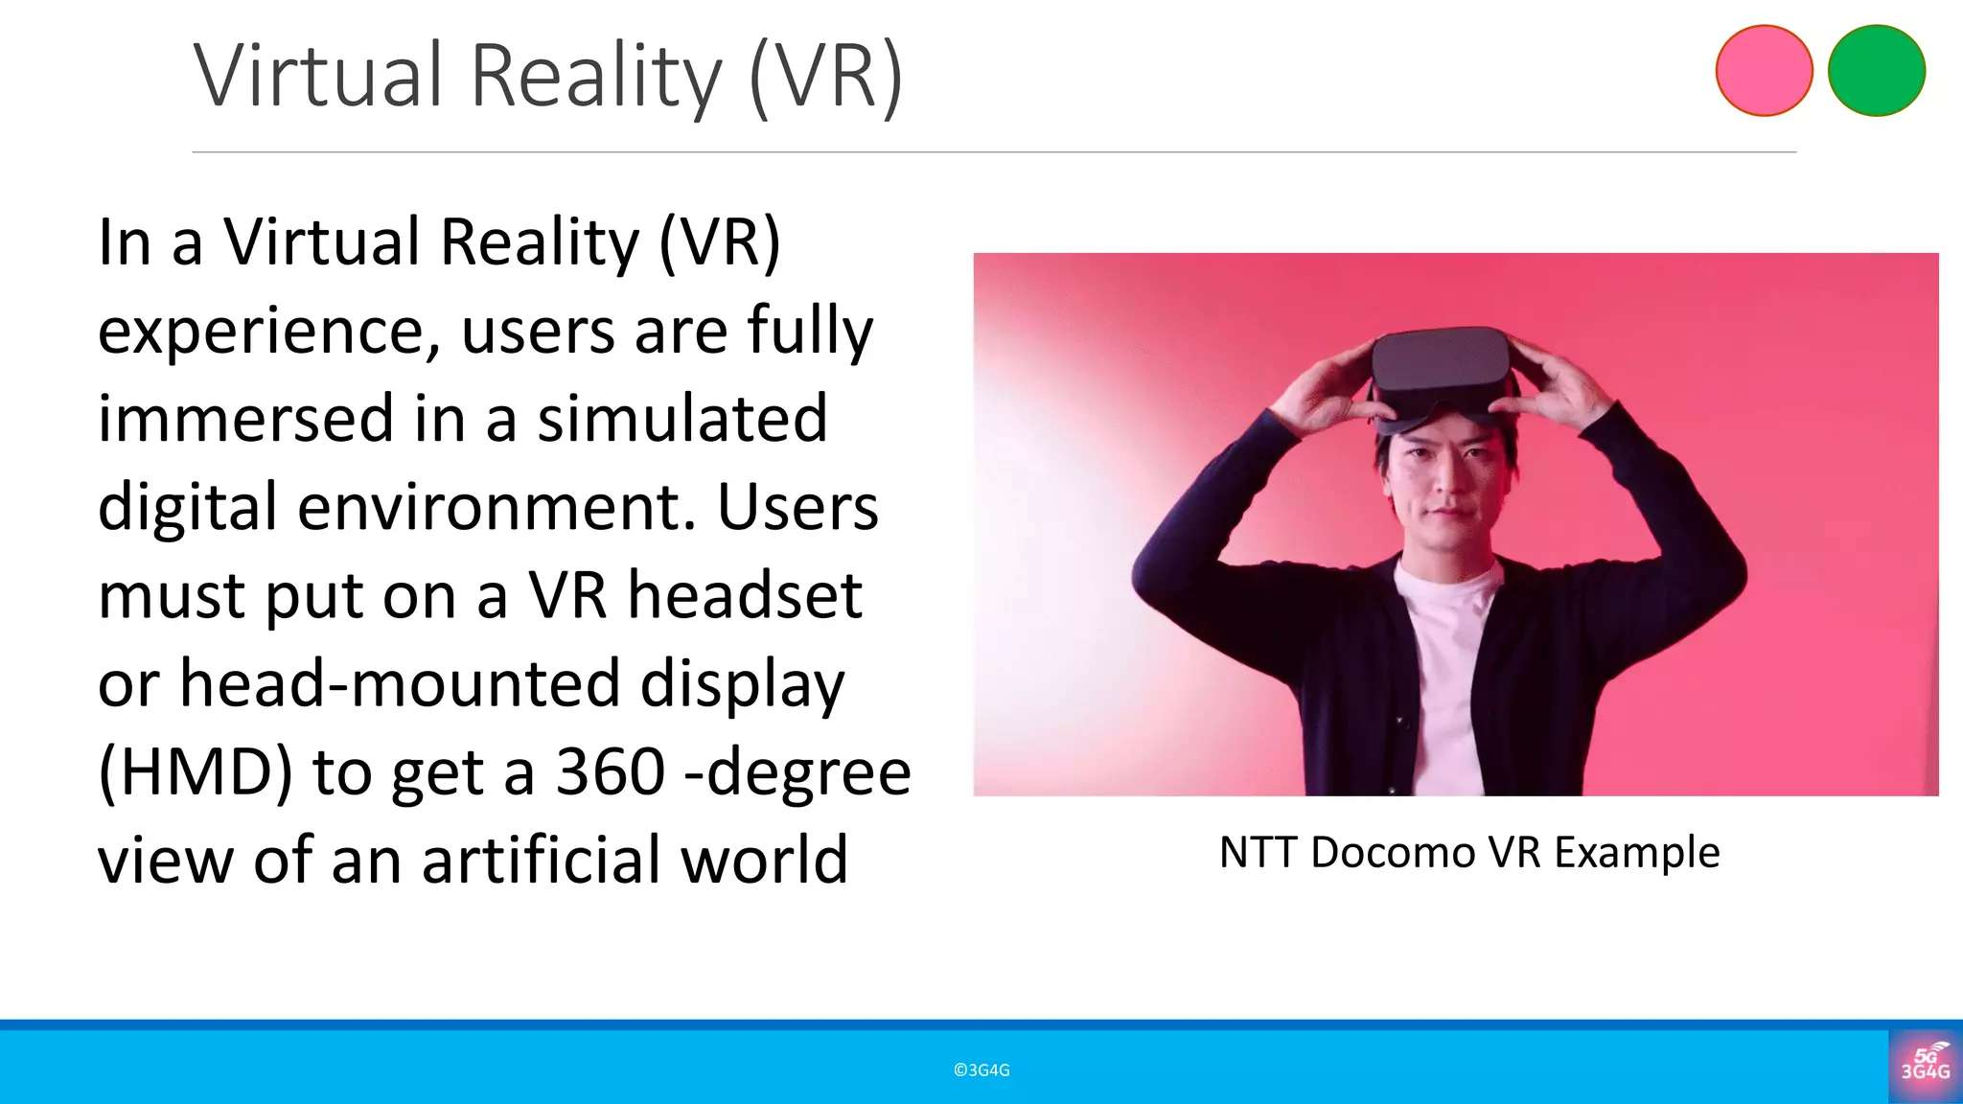

Slide 7
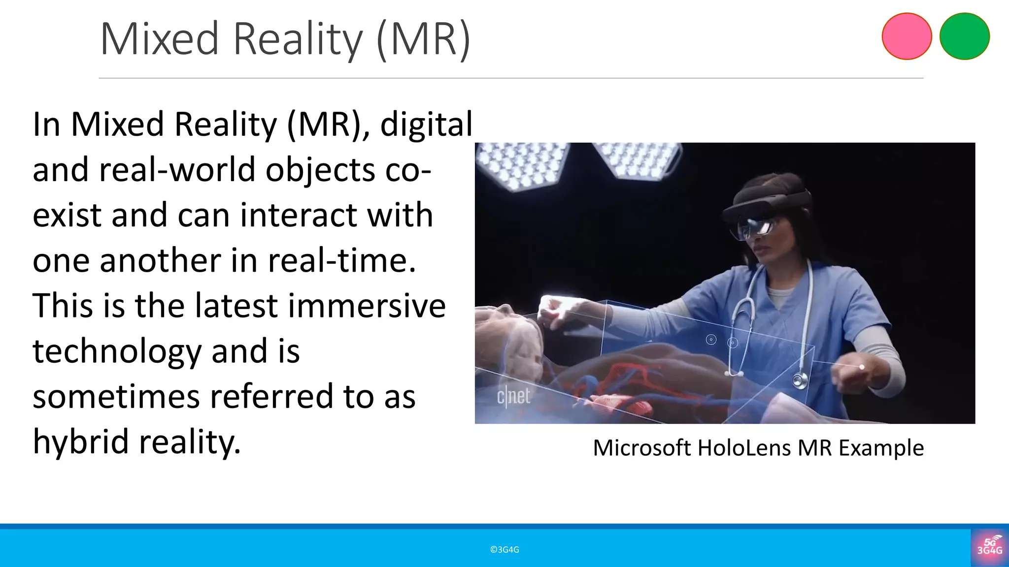

Slide 8
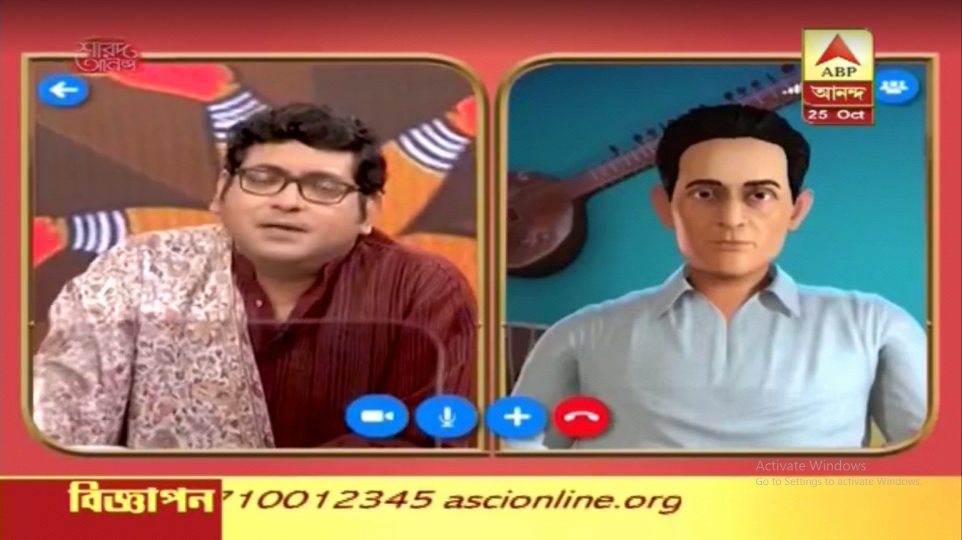
SUMAN SHYAMAL MITRA ( SINGER )
But Suman can interact with Shyamal ( Died) in real time through MR

Slide 9
Remote Healthcare:
Doctors can use HoloLens to remotely diagnose and treat patients, even in remote locations, by visualizing medical data and interacting with virtual models.
Remote Training:
HoloLens can be used to provide holographic instructions and simulations for training purposes, allowing workers to learn new skills in a hands-on, immersive way.

Slide 10
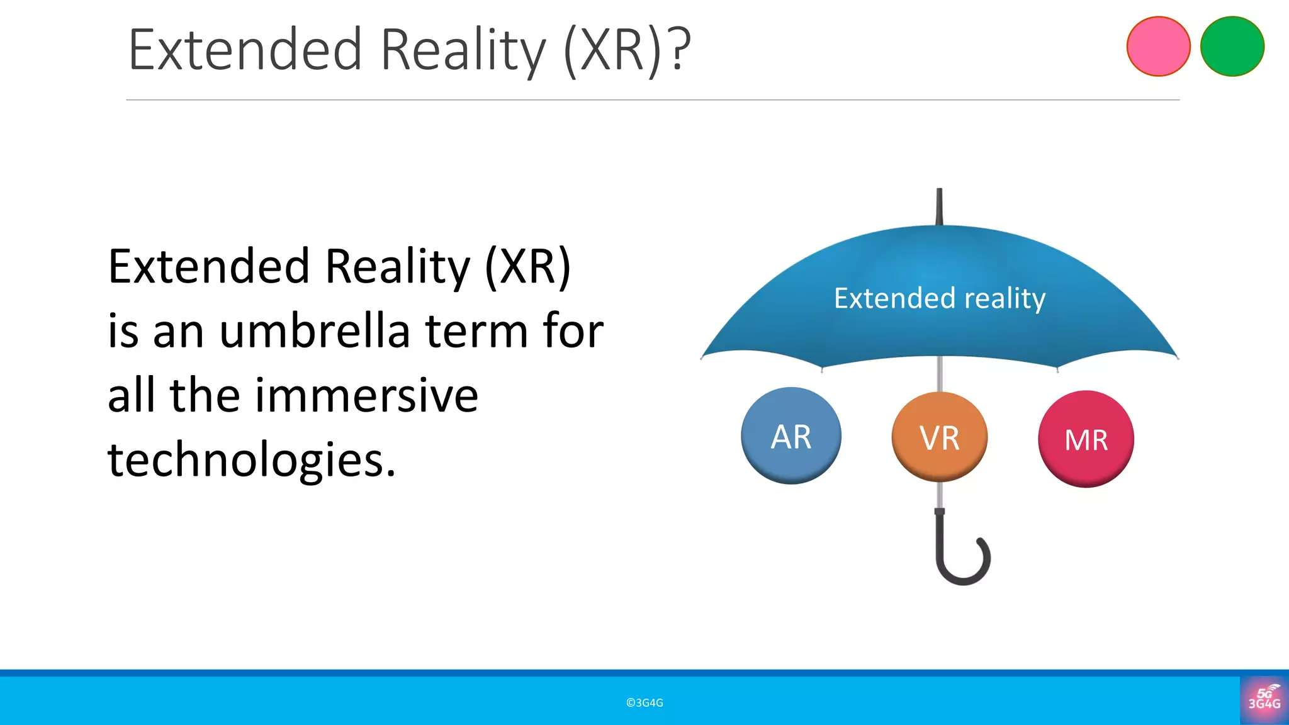

Slide 11
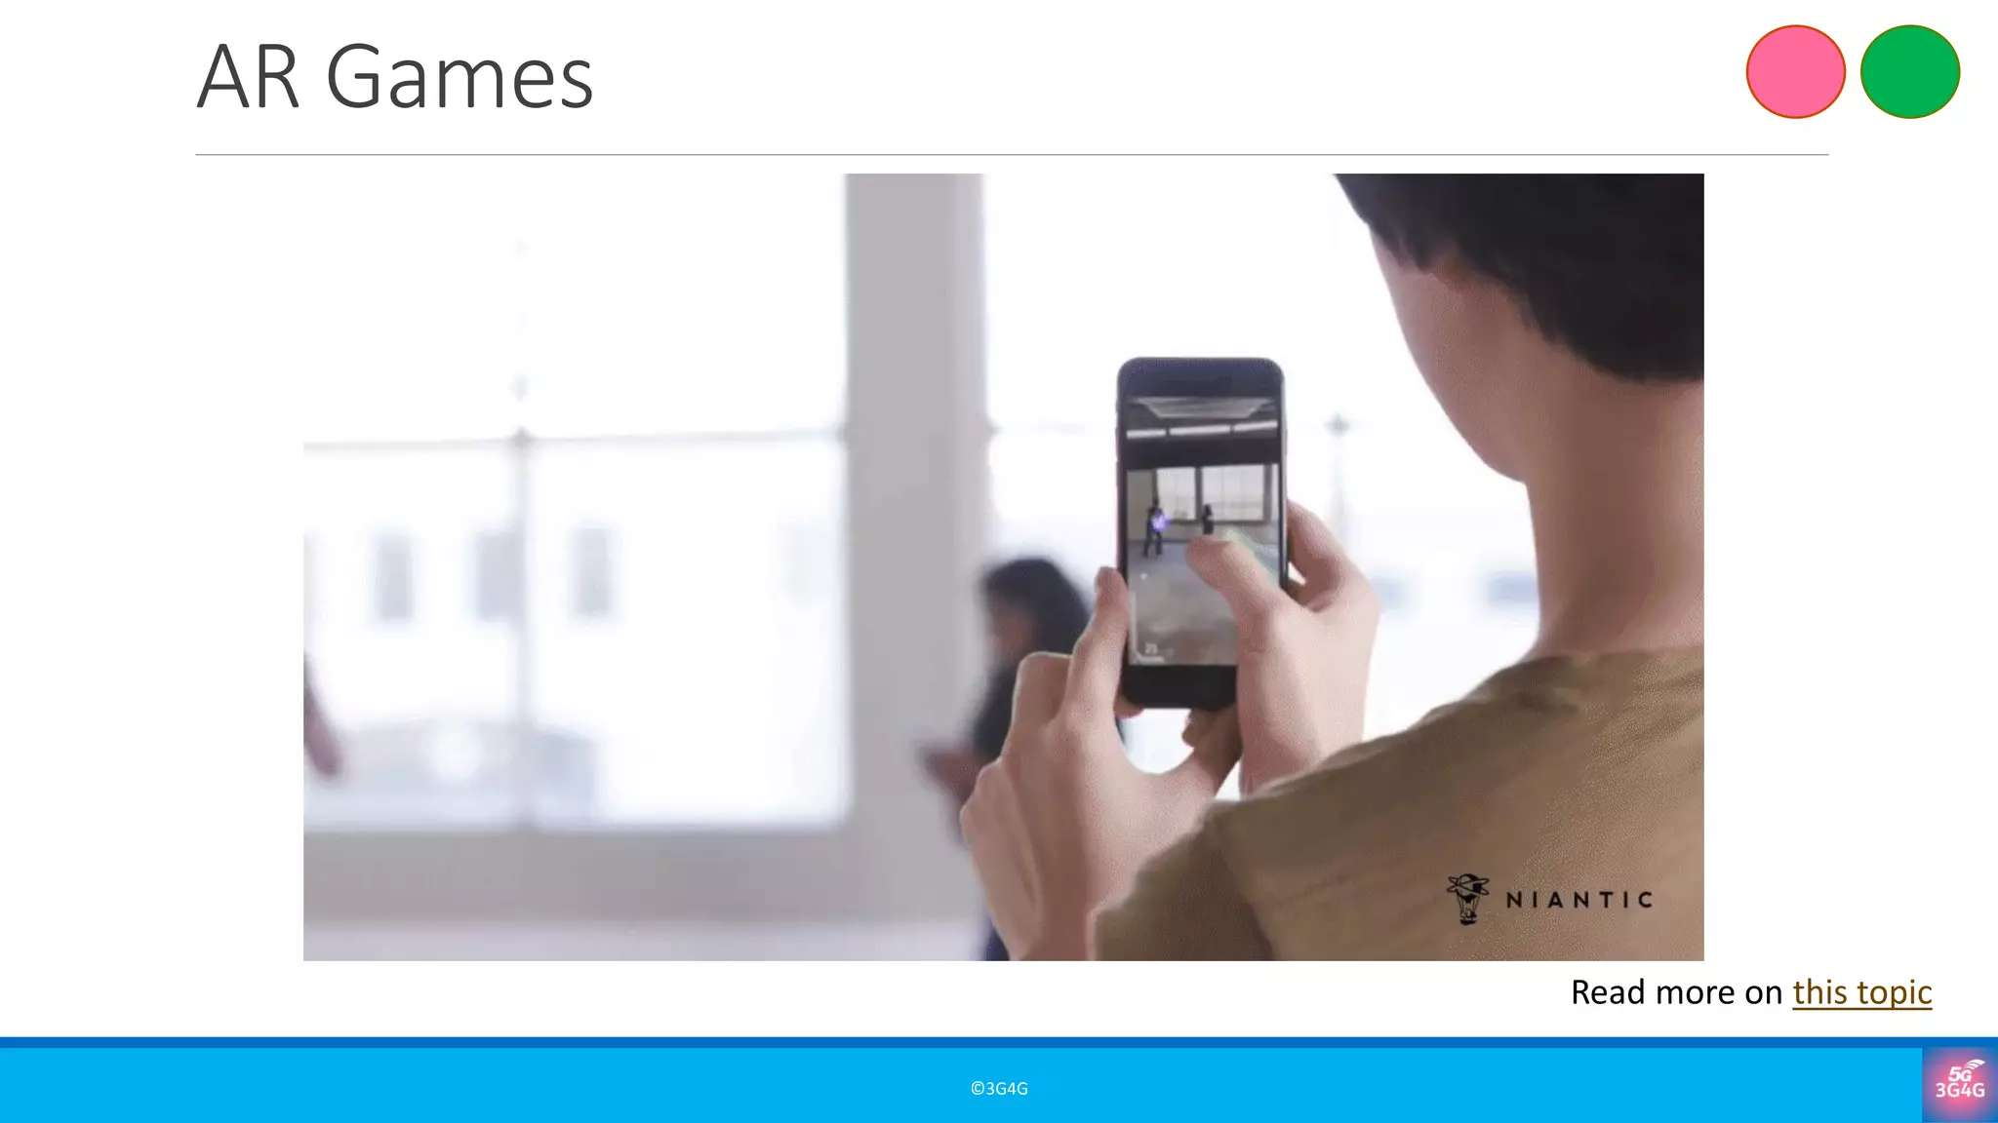

Slide 12
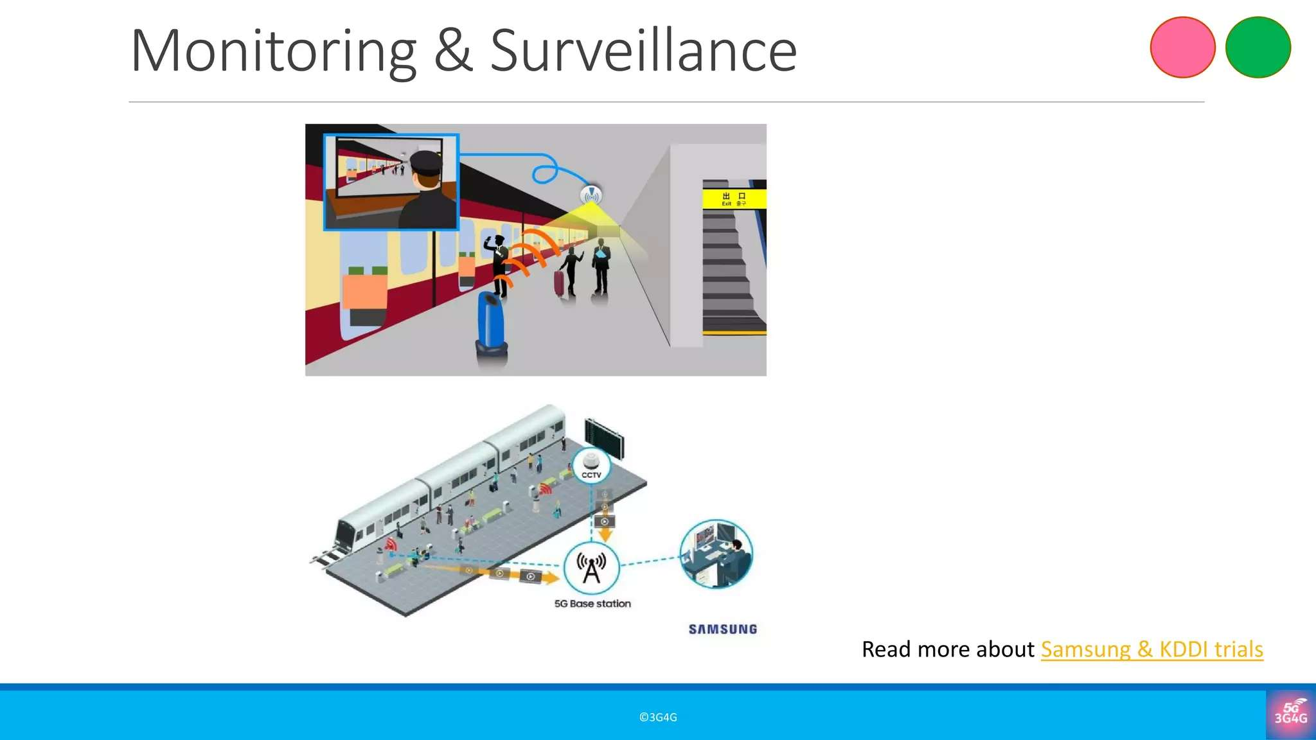

Slide 13
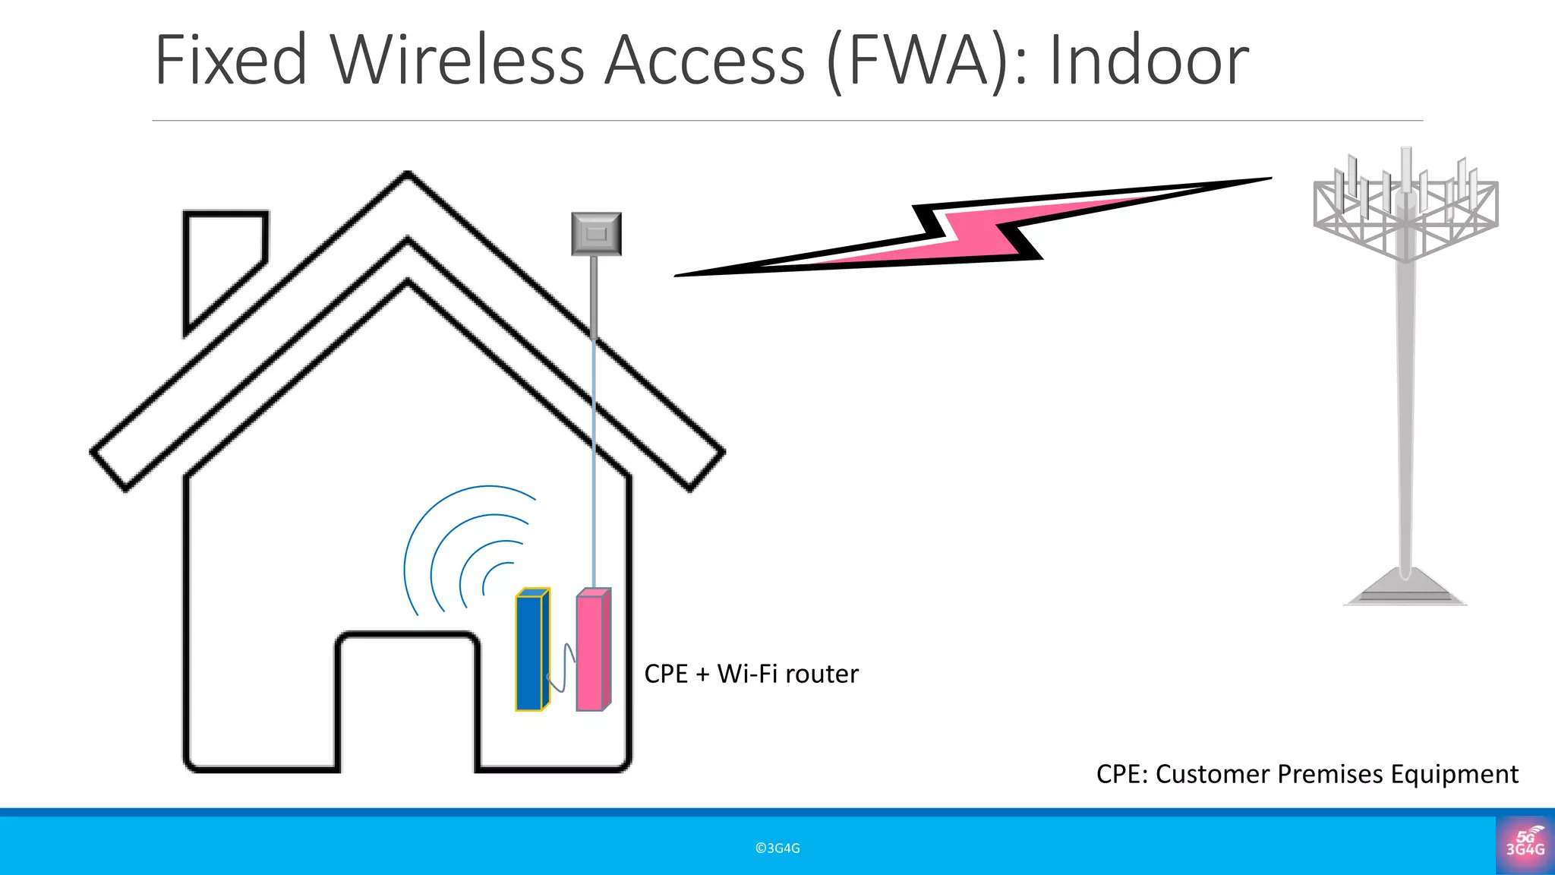
FWA .... Similar to Jio AIr-Fiber
IIIT, KALYANI have one FWA in the name of CPE

Slide 14
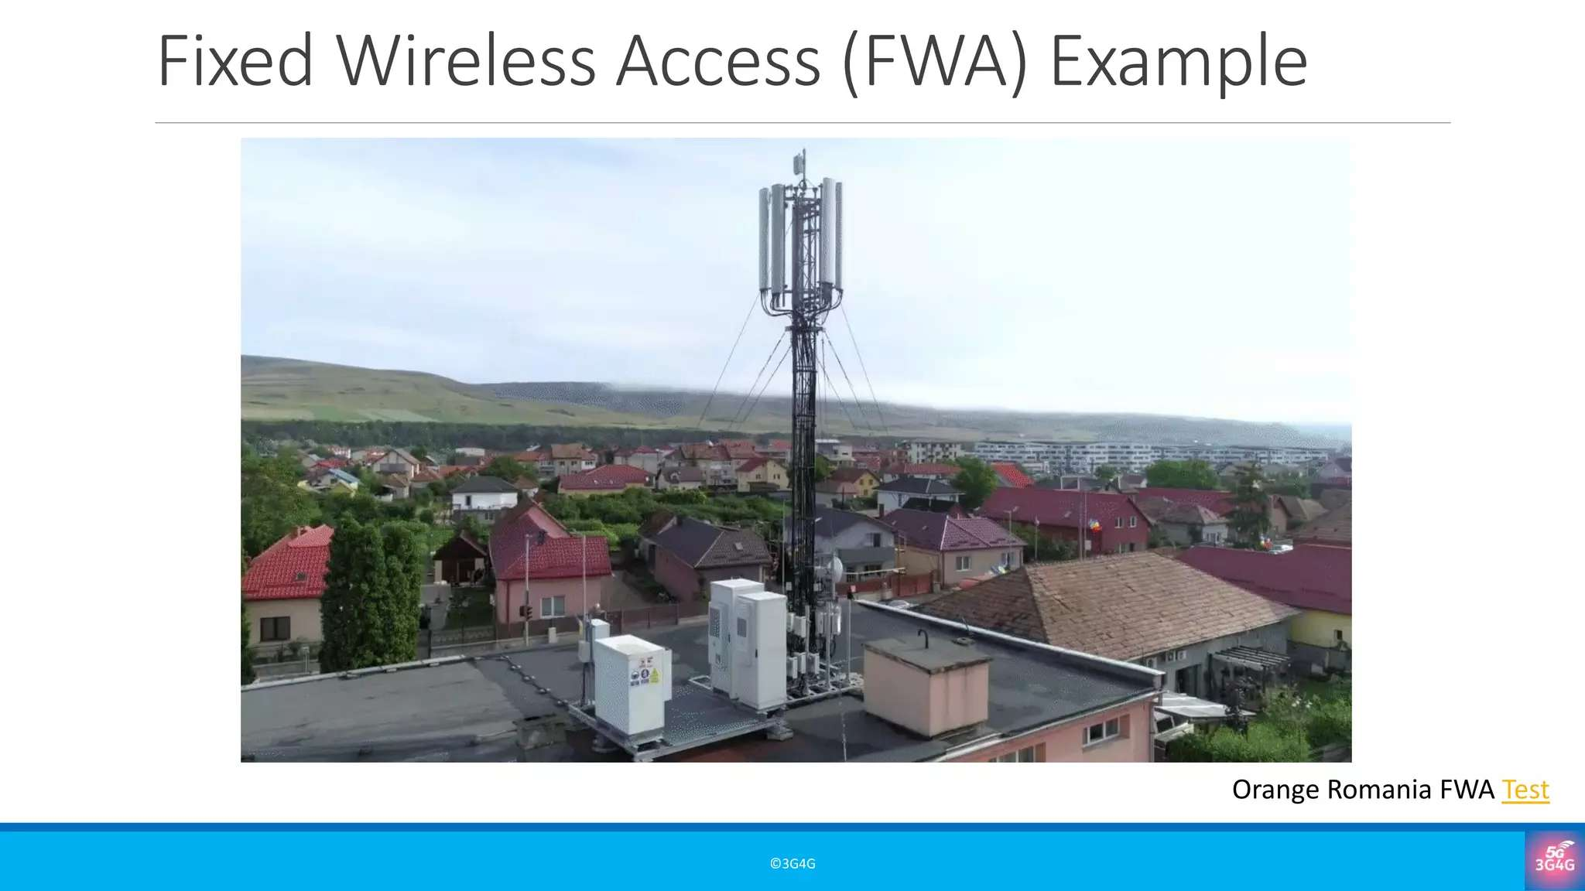

Slide 15


Market Trends and Emerging Opportunities
Ericsson projects that by 2029, there will be 330 million total connections.
In the U.S., T-Mobile aims to hit 12 million 5G FWA subscribers by 2028, while Verizon plans to expand coverage to 90 million households and add 8-9 million new subscribers by the same year. This growth is fueled by strong demand for reliable, high-speed connectivity. In developed markets like North America, average download speeds exceed 140Mb/s. Consumers are also open to speed-based pricing, creating new revenue opportunities where volume-based models once posed challenges.
233
Speed tiers growing in popularity for
5G FWA
LTE
5G
93
Central Asia, 2
Southern Asia, 4
South-Eastern Asia, 8
Eastern Asia, 9
57
Northern Europe, 40
43
36 ₃₄
₃₀ 36
Oceania, 11
Southern Europe, 19
21
North America, 17
36
no data
Western Europe, 19
FASTEST GROWING REGIONS
India
North America
APAC
Middle East, 22
Eastern Europe, 18
Latin America and the Carribean, 20
Sub-Saharan Africa, 22
Source: Global mobile Suppliers Association GSA 2024 a Year in Review

Slide 16




RRU*
Outdoor CPE roof or wall mounted
RRU
Window mounted
CPE
* Remote Radio Unit
** Residential Gateway
Indoor CPE (built in RGW**)

Slide 17
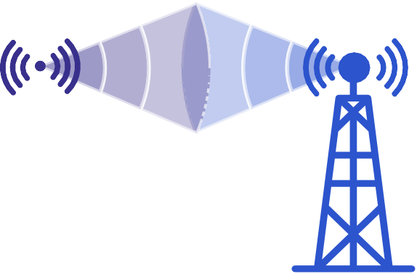
FWA TESTING - FROM LAB TO LIVE
5G Home Gateway Connectivity Architecture
5G CORE
Internal home Wi-Fi network
Mobile Service Provider / Internet Provider
High-speed wireless internet signal from the Mobile ISP
5G
Home Gateway
User Equipment (UE)
5G Home Gateway ...
Serving Side ... 5G Base station and 5G CORE Network
USER Side .... NON-5G UE , SMARTPHONE ( WiFI Mode) and others UE with WIFI mode
END USER

Slide 18
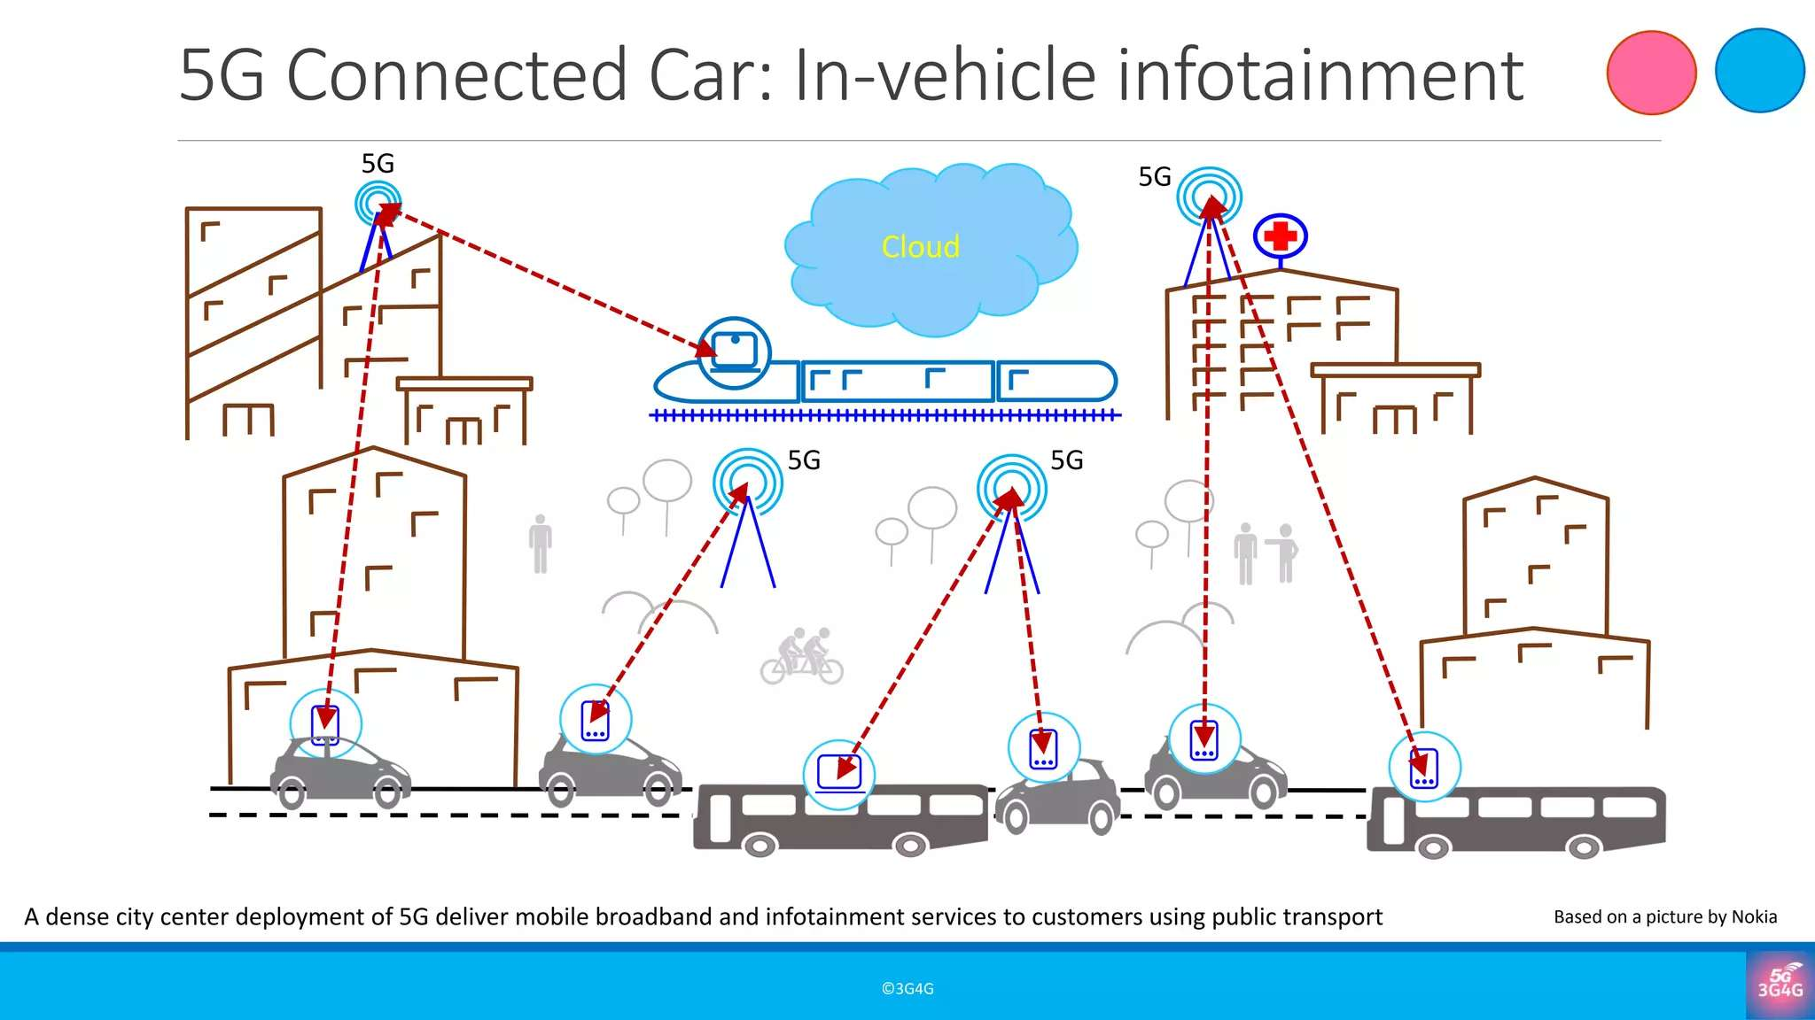

Slide 19
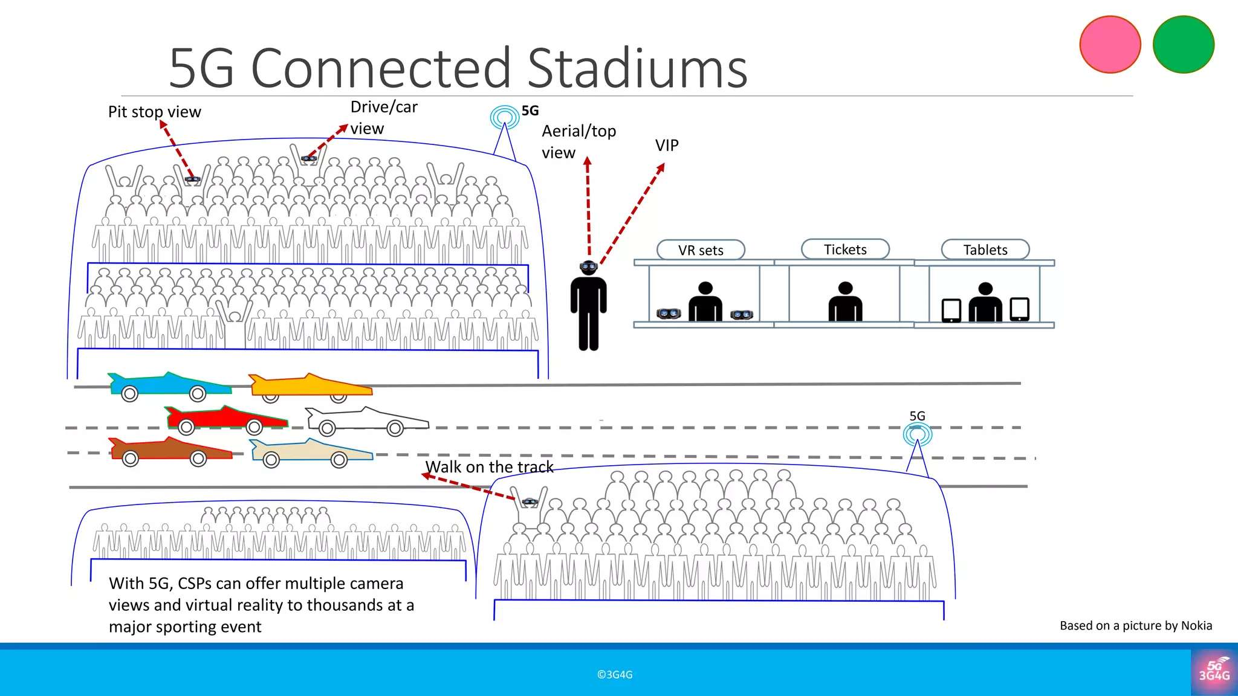
mMTC use case in 5G Stadium

Slide 20
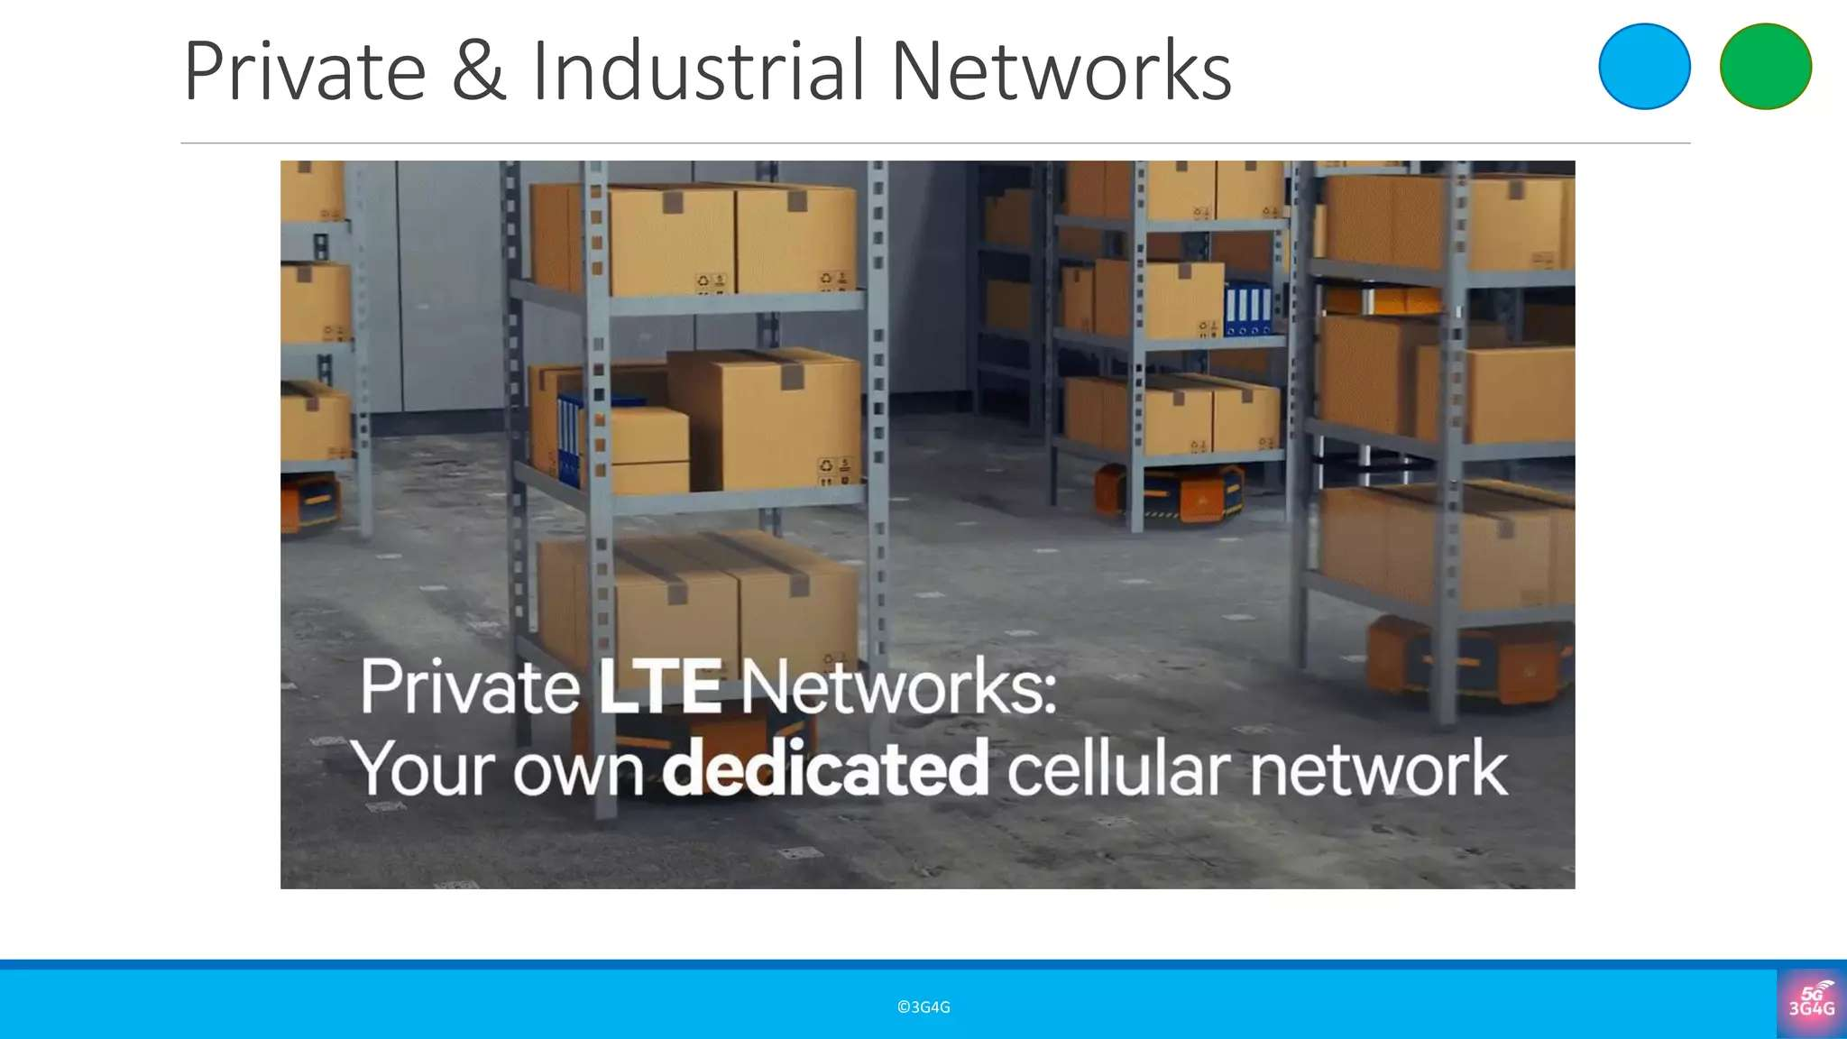

Slide 21
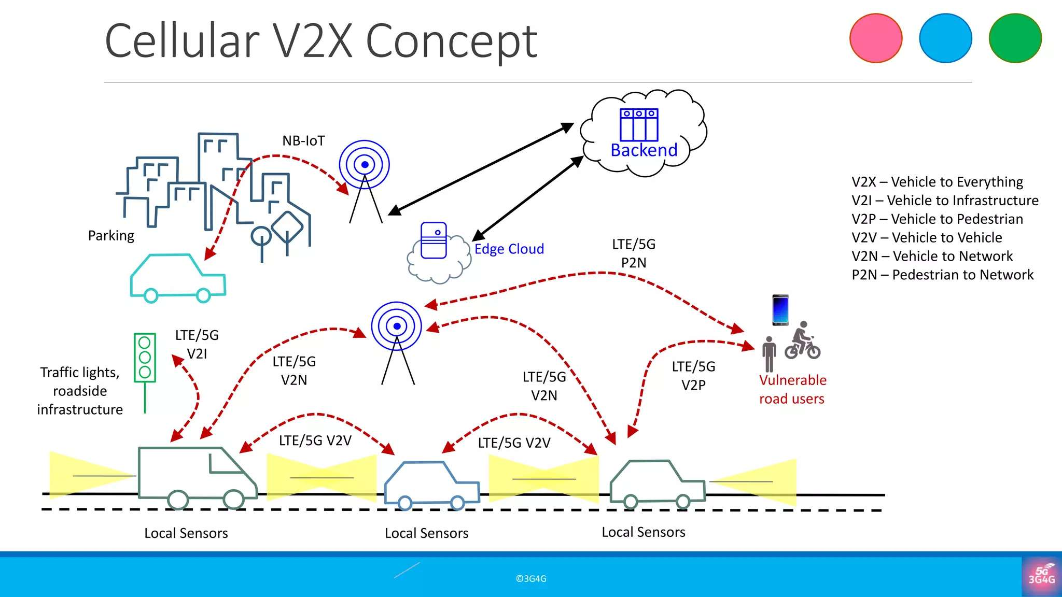
URLLC use case in Industry and Cars

Slide 22
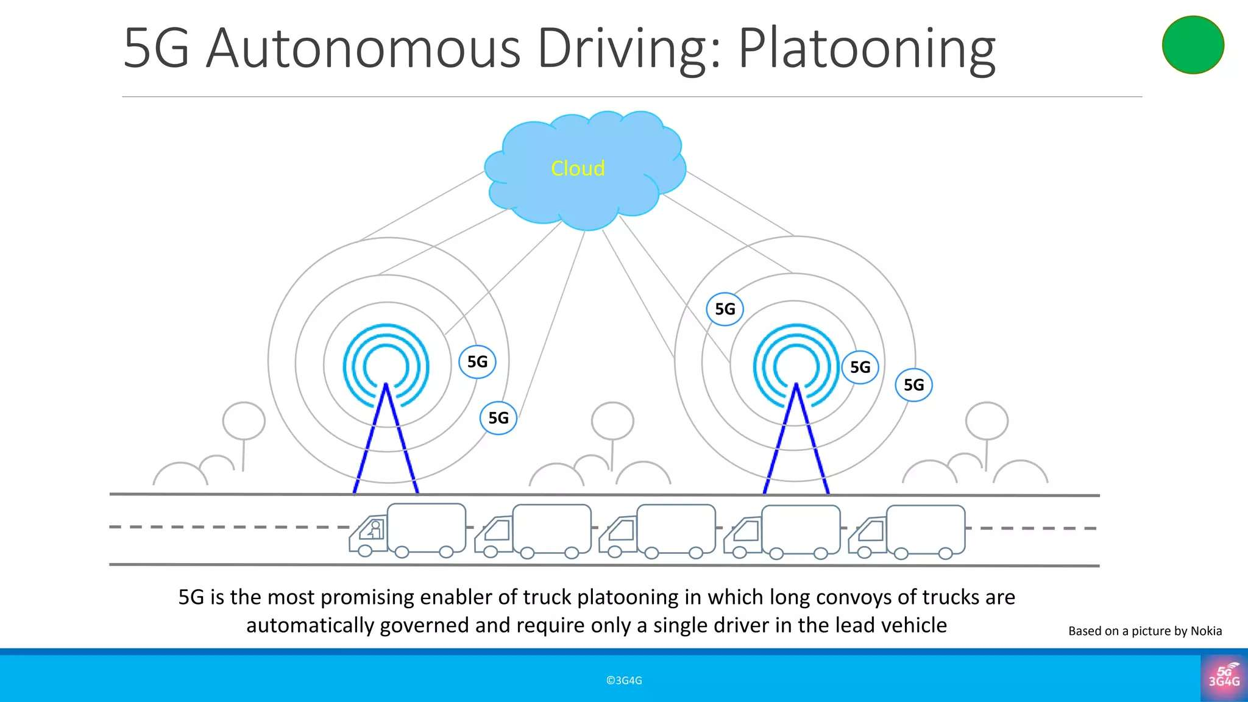
URLLC use Case in Vehicle Platooning

Slide 23
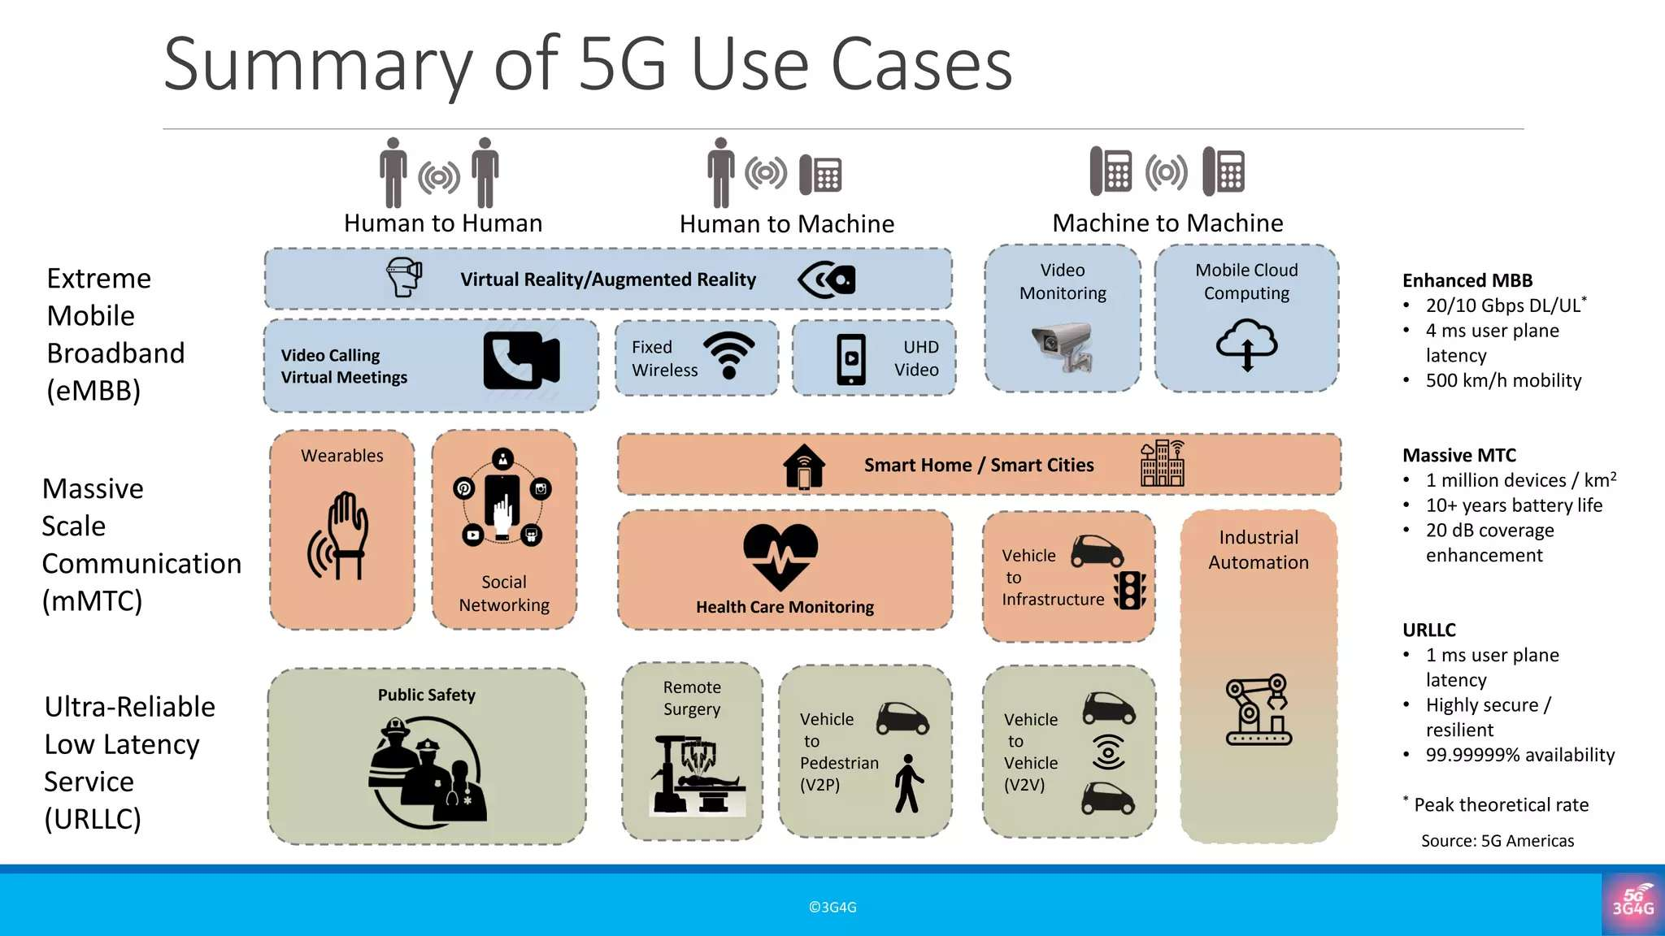

Slide 24
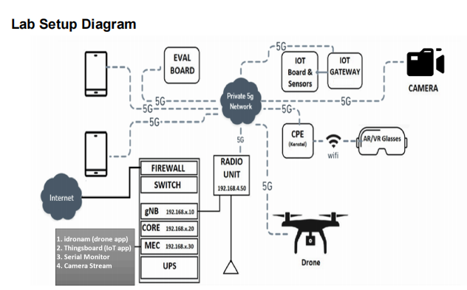
100 5G Use Case LAB at IIIT, KALYANI , Sponsored by Dept of Tele ( DoT)

Slide 25
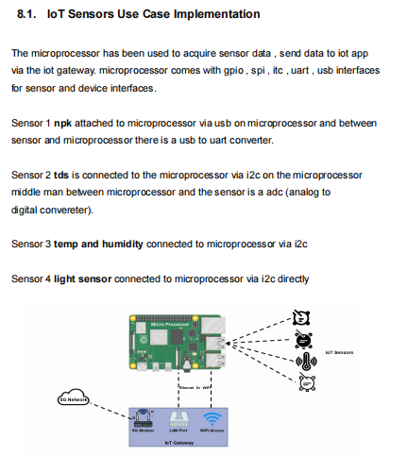
Raspberry PI
Microprocessor
TDS... Total Dissolved Solids / Total Dissolved Solids Sensors. Most TDS applications are used to monitor dissolved solids levels
5G Network
IoT Gateway

Slide 26
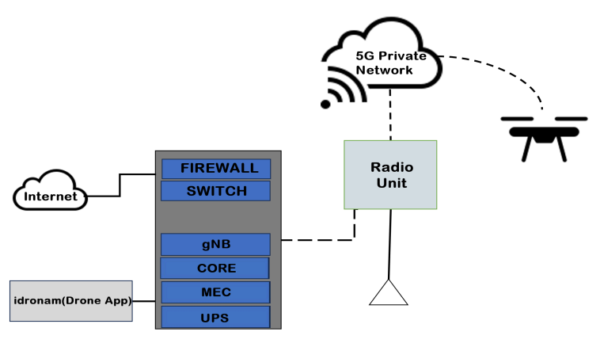
5G DRONE with AI enabled Video Analytics at IIIT, KALYANI

Slide 27
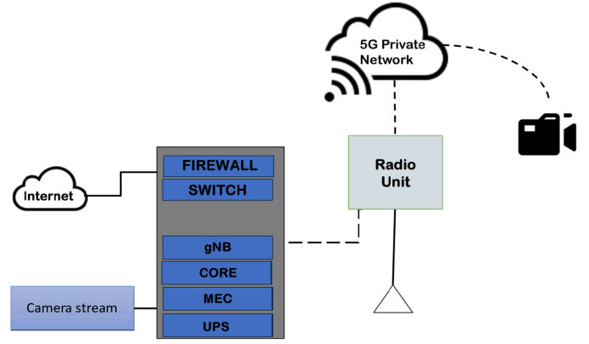
5G CAMERA with AI enabled Video Analytics at IIIT, KALYANI
MEC... Multi-Access Edge Computing
gNB .. g NODE B ( 5G Base STATION)

Slide 28
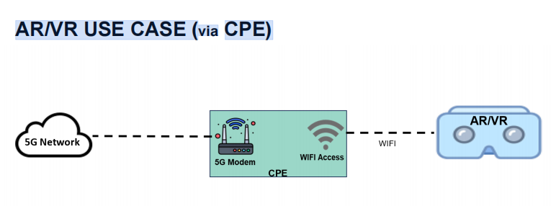
AR/VR USE CASE (via CPE) at IIIT, KALYANI

